Slide 1
Classification
Tianhang Zheng
https://tianzheng4.github.io

Slide 2

Quantitative vs Qualitative Outputs
Regression mainly study quantitative outputs
$$Y=β_{0}+β_{1}X_{1}+β_{2}X_{2}+…+β_{p}X_{p}+ε$$
Classification mainly study qualitative outputs
Qualitative variables take values in an unordered set, i.e.,
$$eye color∈\left\{brown, black, green\right\}$$

Slide 3



Why not Linear Regression
Binary Classification: $Y=\{0, 1\}$
$$\hat{y}={\hat{β}}_{0}+{\hat{β}}_{1}x$$
As long as ${\hat{β}}_{1}$ is not zero, the prediction could be larger than 1 or smaller than 0
Logistic regression is more appropriate!

Slide 4
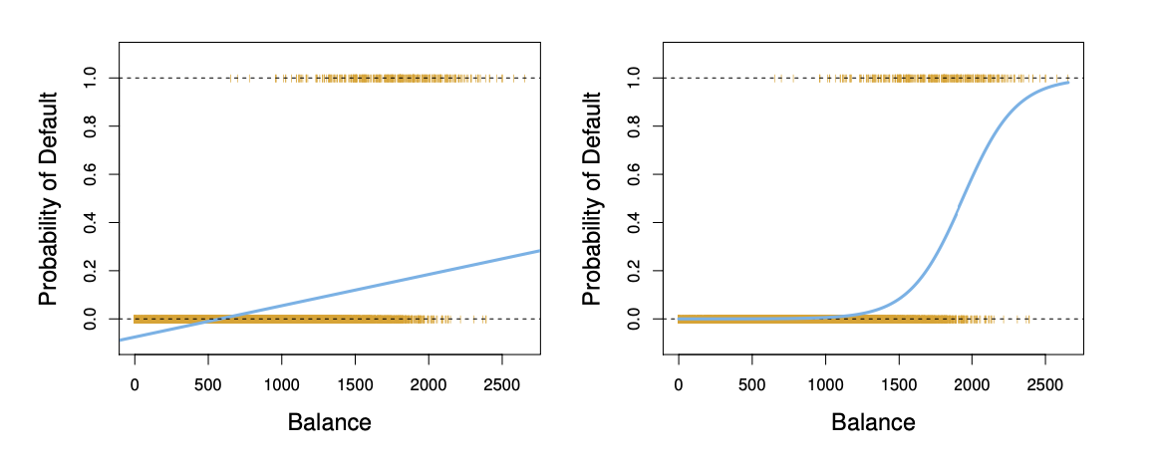
Linear Regression vs Logistic Regression

Slide 5
Q & A

